Slide 1
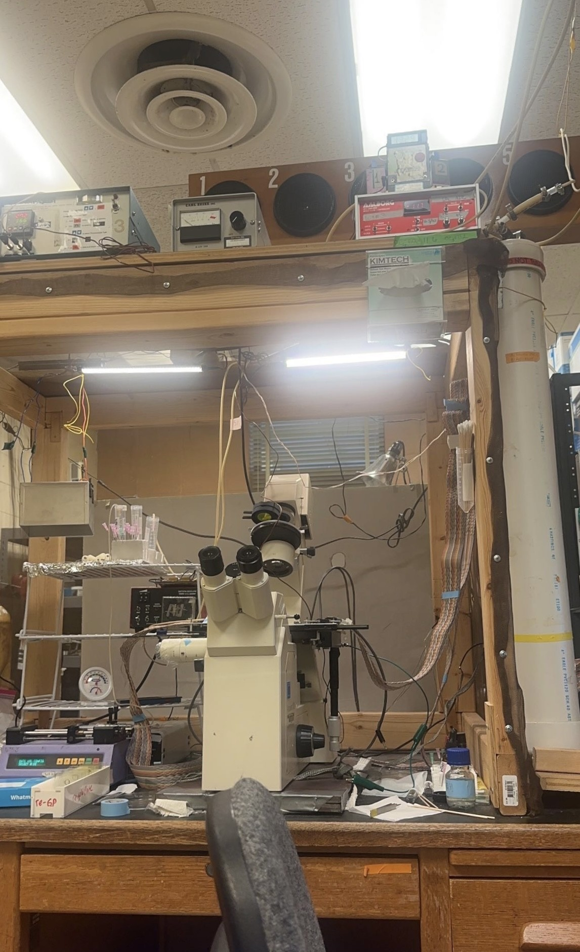
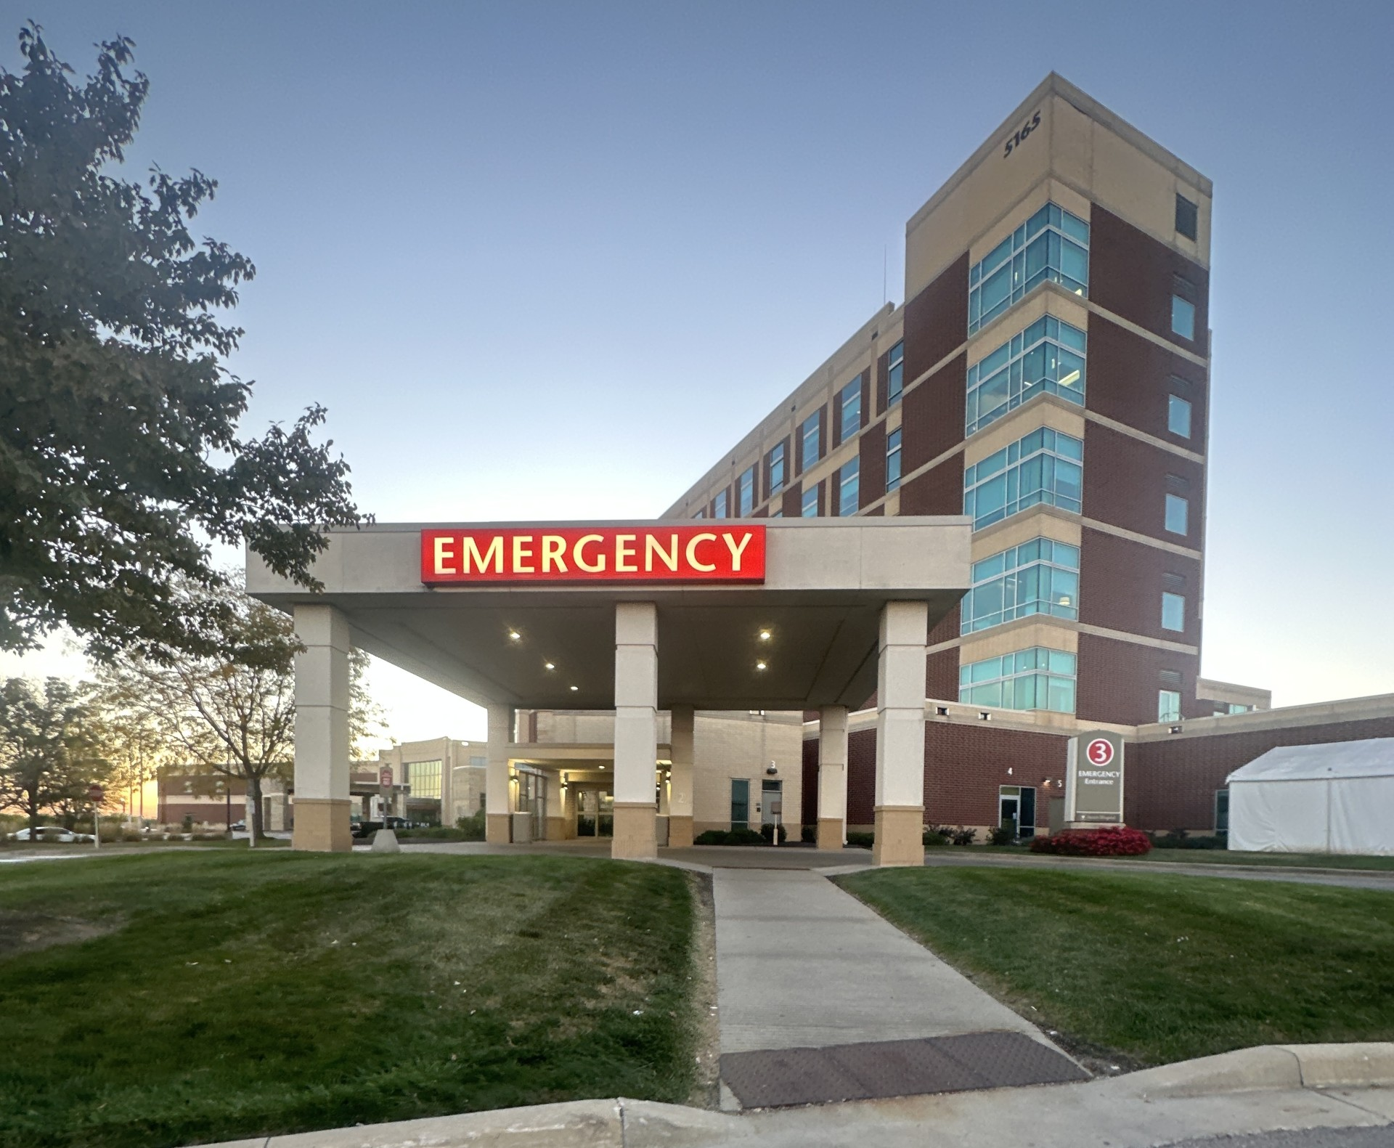
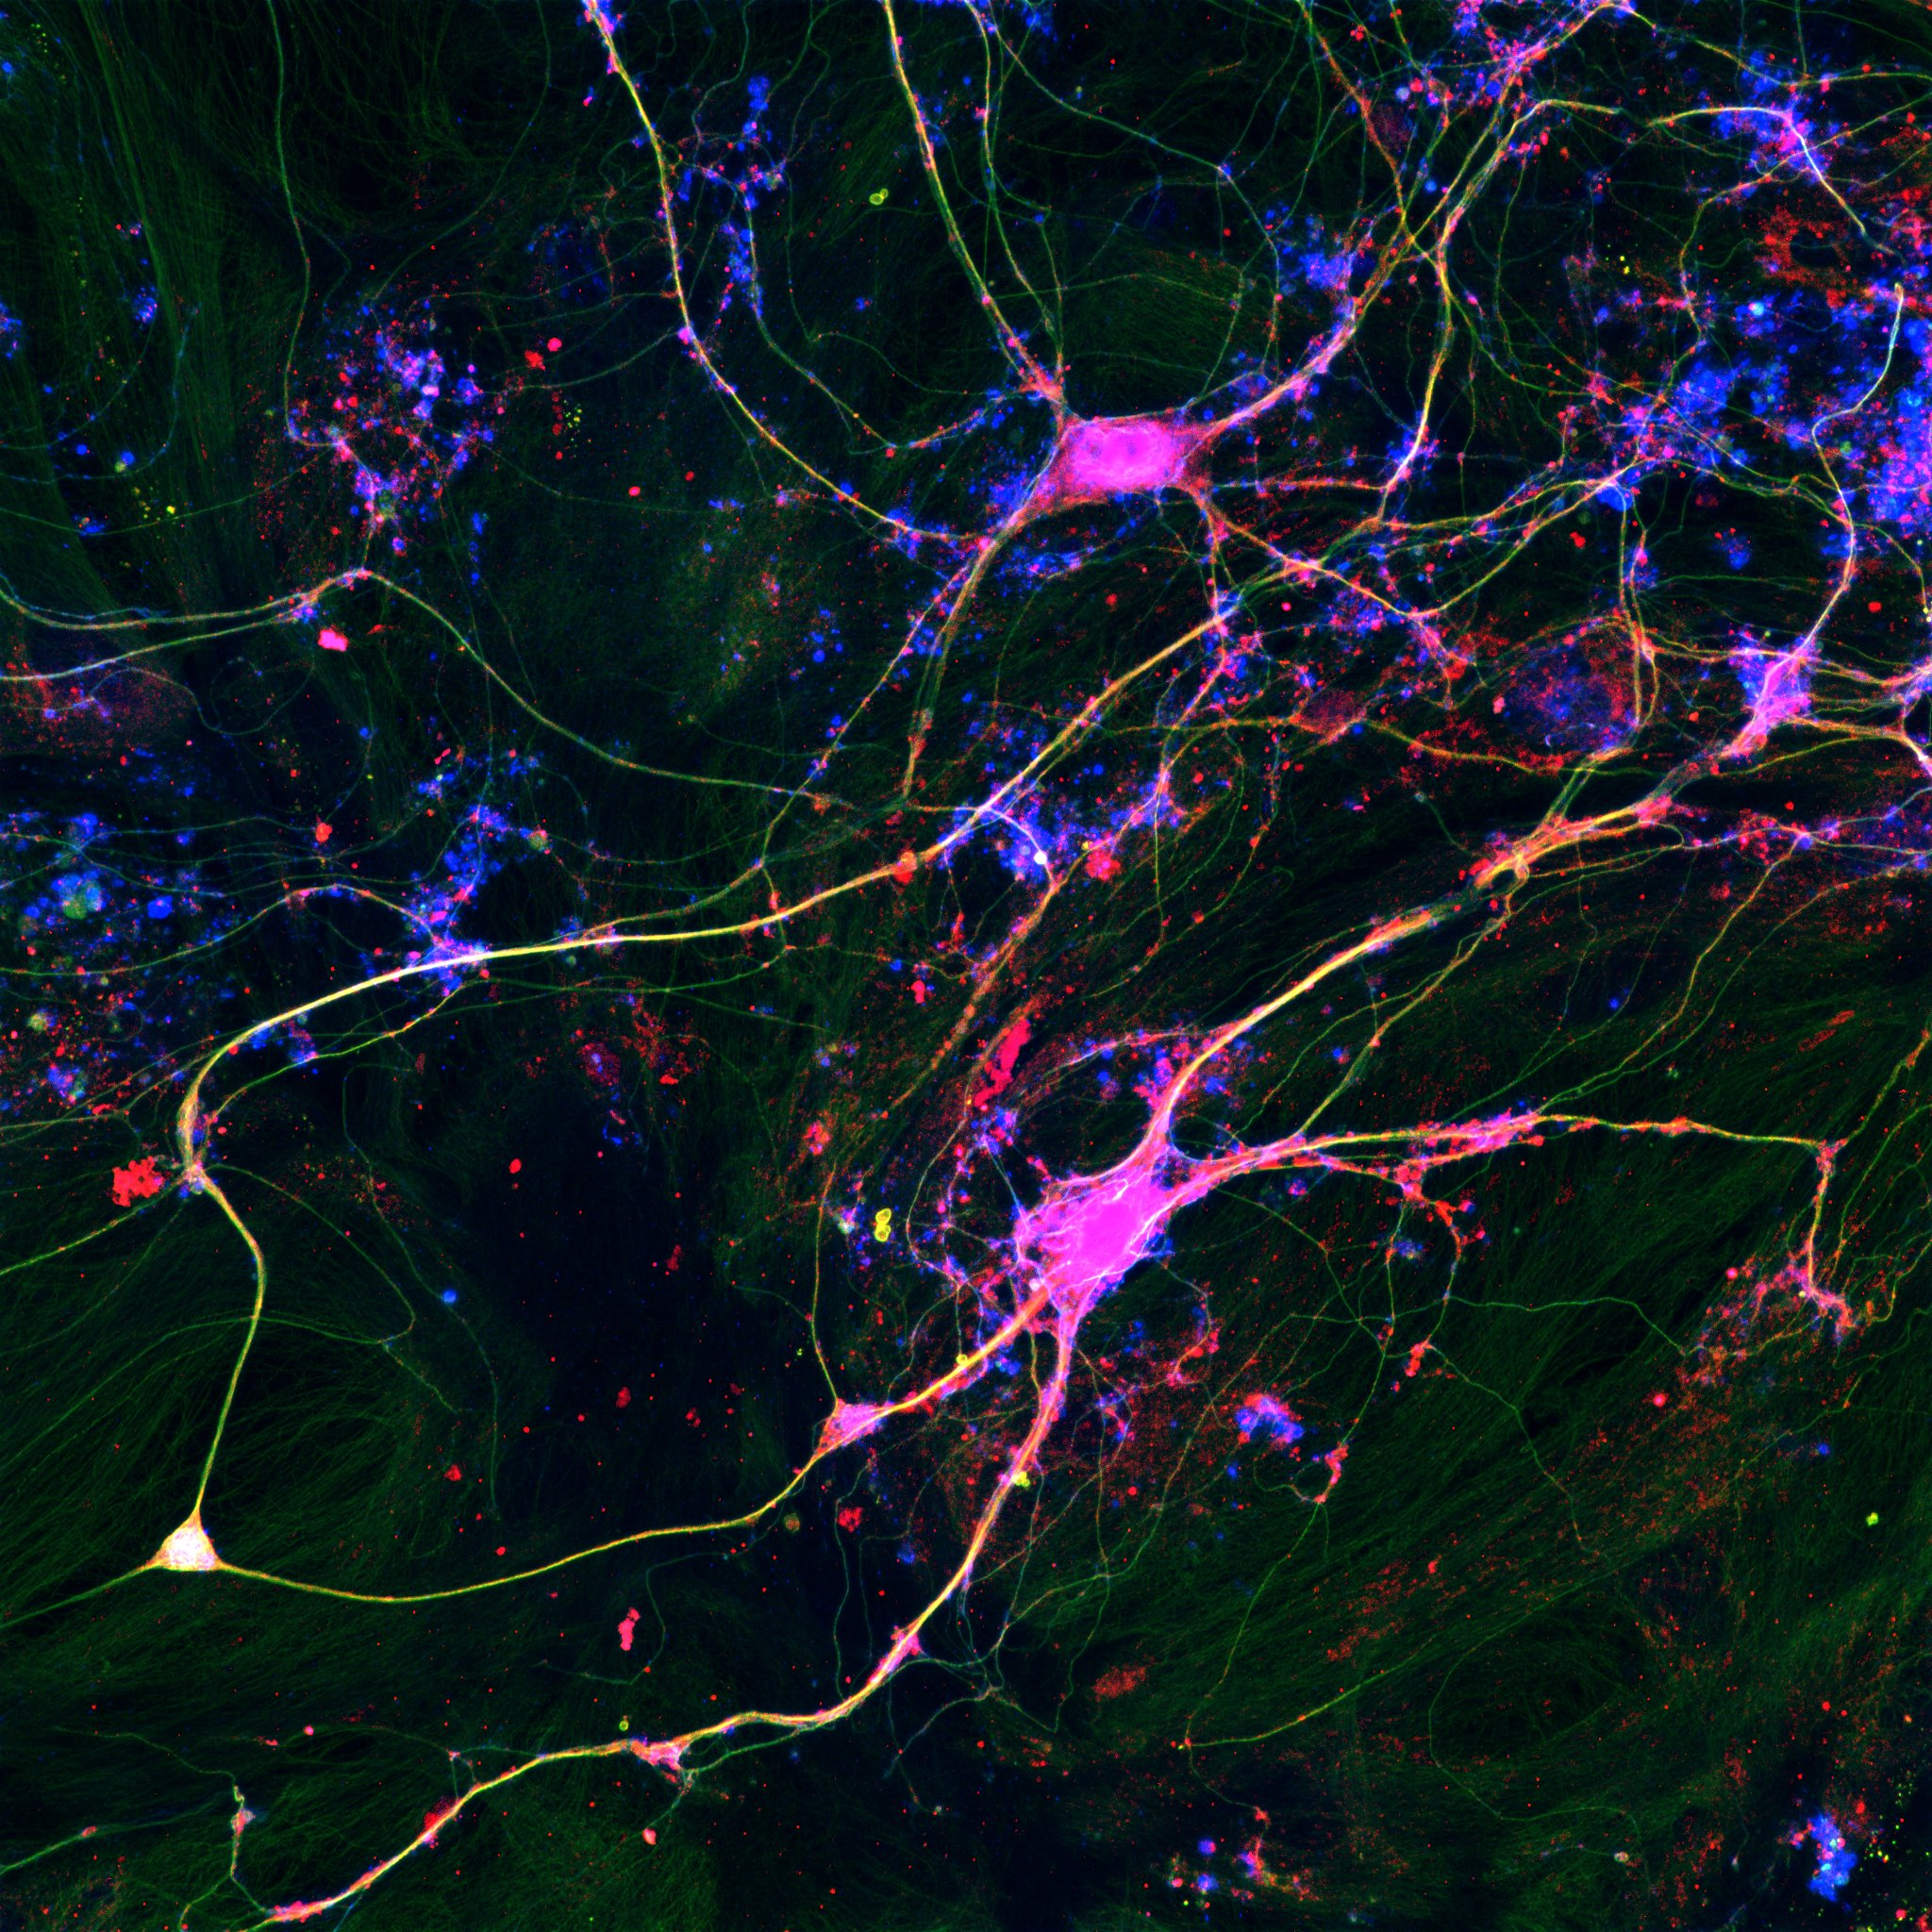
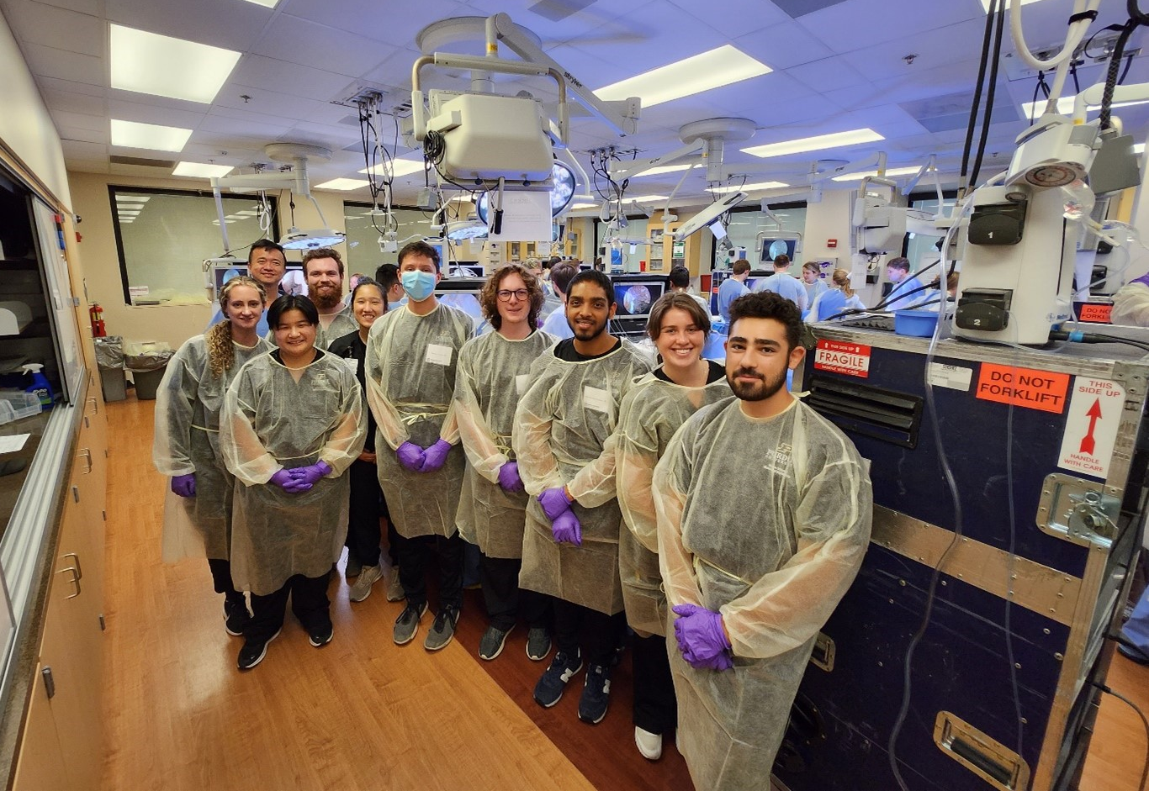
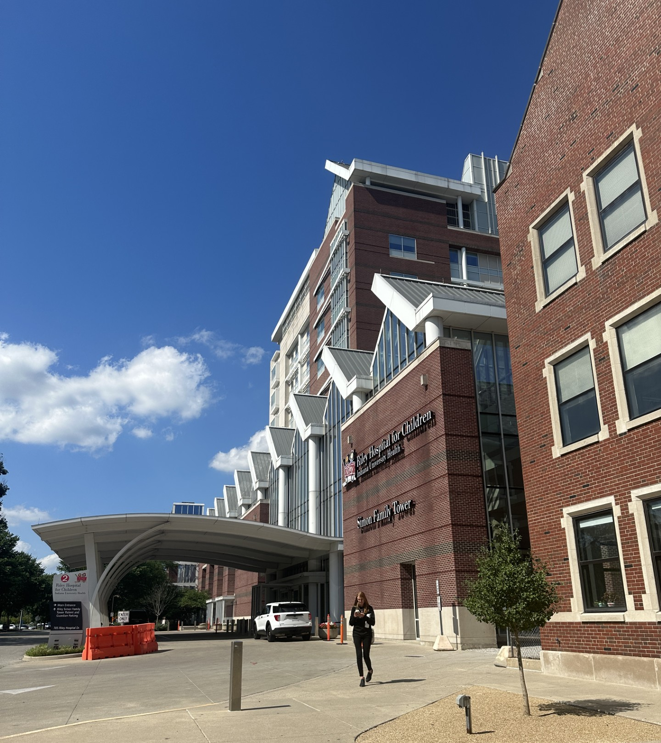
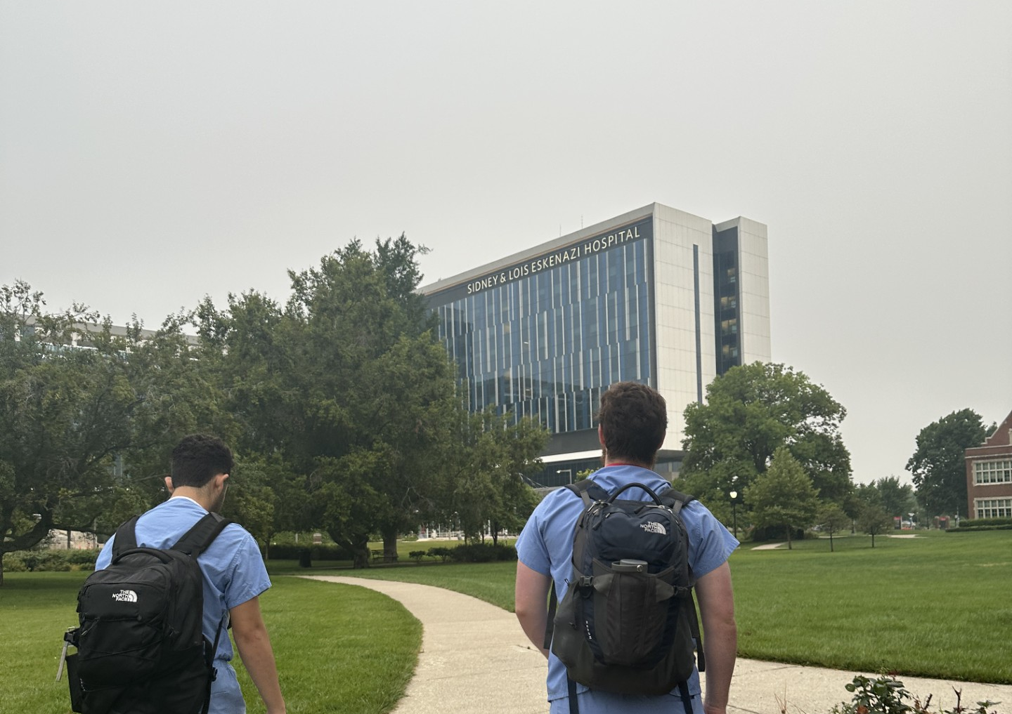
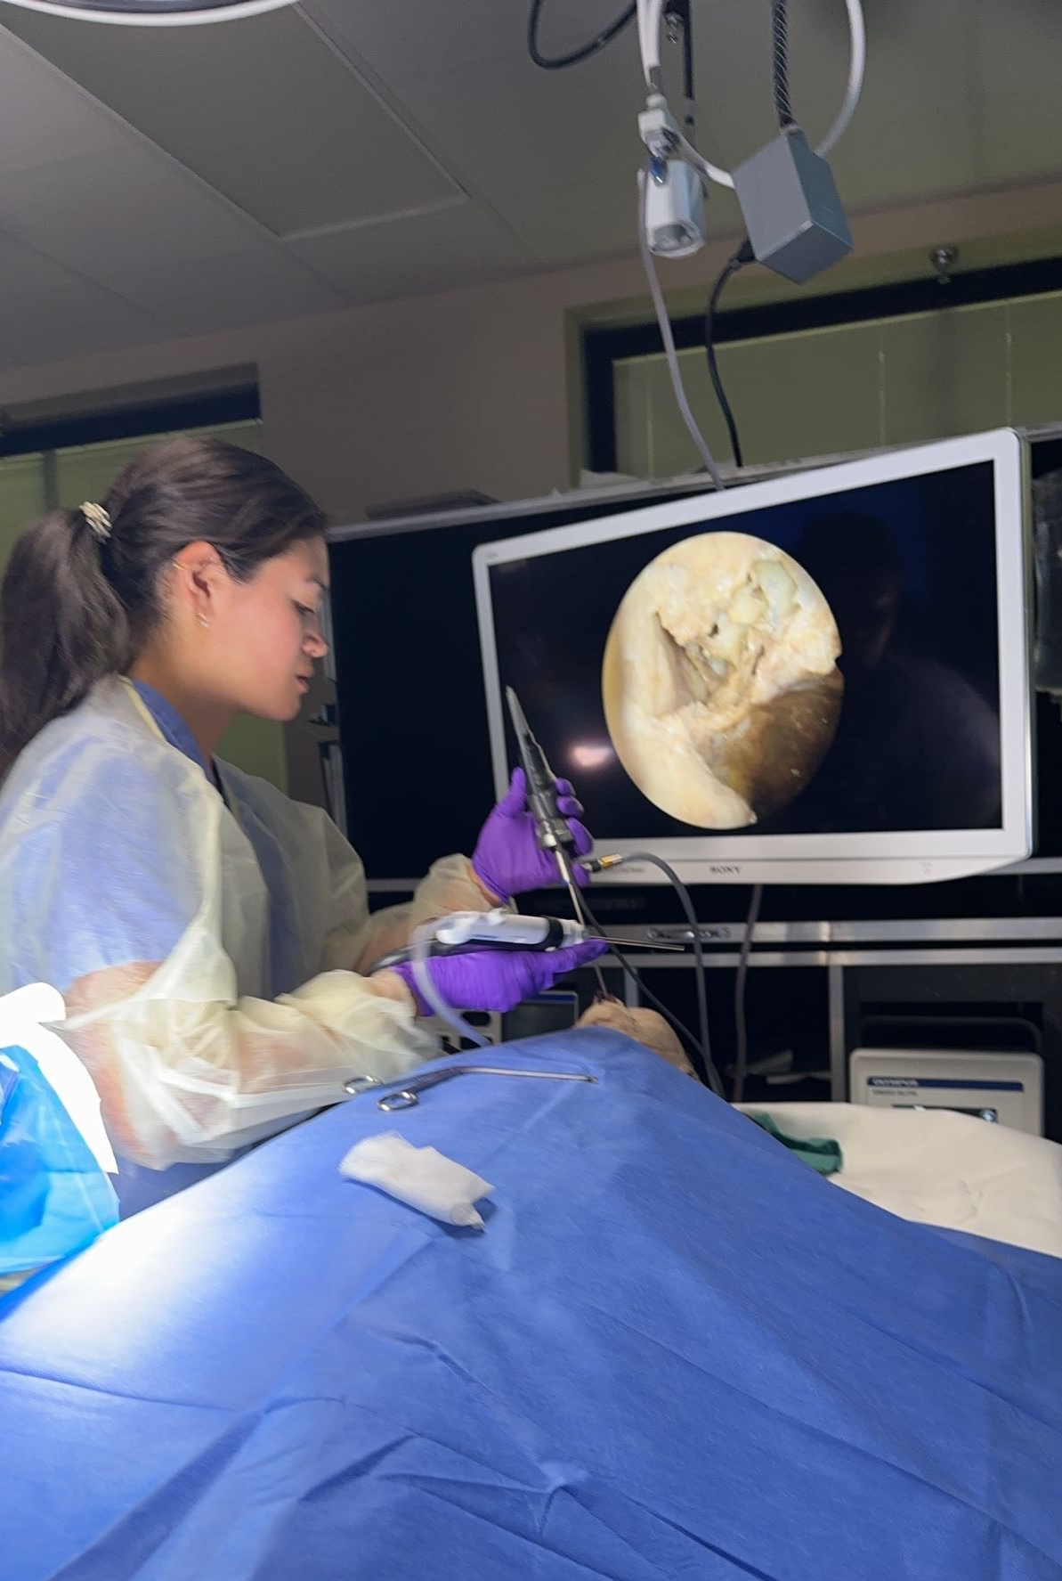
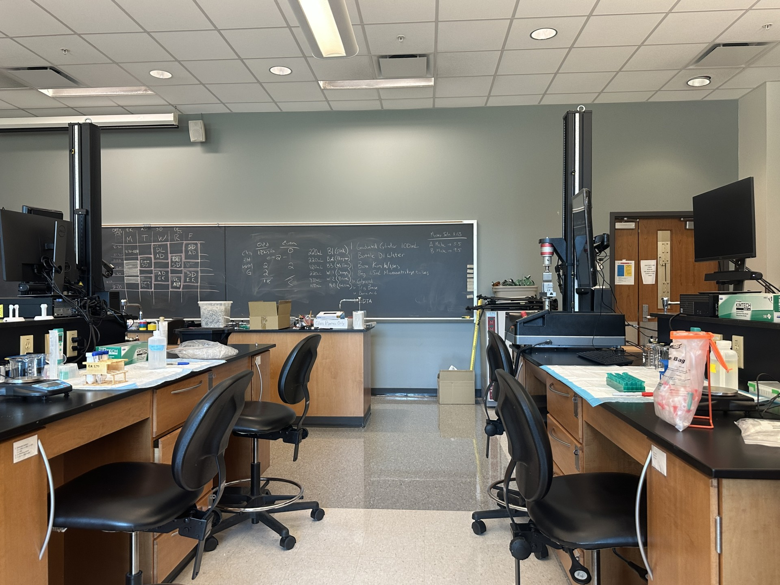
Emma Adolay
Expected Graduation: May 2025
Pre-Medicine Focus
Research Experience
Emergency Room Medical Scribe
IU Health Arnett Hospital
500+ documented clinical hours to date
Document patient encounters, including medical history, physical exams, and procedures, in electronic health records (EHR) systems
Purdue Center for Paralysis Research (CPR)
Working under Dr. Riyi Shi and Shatha Mufti, PharmD
Investigating mechanisms that underlie seizure development after traumatic brain injury (TBI)
Studying electrophysiological and morphological changes in neuronal networks post-injury
IUH Clinical Immersion Program – INTENT
Hosted by IU School of Medicine
Earned approx. 25 hours of surgical shadowing experience at IUH Methodist, Eskenazi, Riley’s, and University Hospital
Networked with industry professionals from medical device companies
Leadership within BME
Other experience:
Cardiovascular OR and IR shadow through BME 460
Internal Medicine shadow at VA Clinic
Psychology minor
Undergraduate Teaching Assistant (UGTA) Experience
BME 32001 (previously 205): Biomolecular and Cellular Systems Laboratory
BME 256: Physiological Modeling in Human Health
Alpha Eta Mu Beta (AEMB), Purdue Chapter of the National BME Honor Society
Secretary 2023-24
President 2024-25 (current)
Weldon School of Biomedical
Engineering Ambassador
Senior Design Project
Mentored by Dr. Nan Kong and Dr. Charles Babbs
Non-invasive, at-home diagnosis and differentiation of PCOS
and endometriosis
Provider web application for OB/GYN clinics + patient mobile app
NIH RADx Tech ACT ENDO Challenge

